Slide 1
Machine learning project
By:
Daniel kinyua-673956
Kowsar Abdikadir-673607
Allan losenge-673447
Georgette Gitonga -673422

Slide 2

Each person’s contribution
Daniel kinyua- Animation of the graphics in the blog
Kowsar abdikadir- Coming up with the graphics.
Allan losenge-The front end of the blog.Using Html and css
Georgette Gitonga- A machine learning model using an excel spreadsheet .

Slide 3
Lesson learnt from the project.
First lesson learnt is collaboration.
Content wise, use of hardware and operating systems
Networking- use of video conferencing to collaborate
Data transfer and analysis by using of excel and how data can be used to make decision and process unseen data.

Slide 4
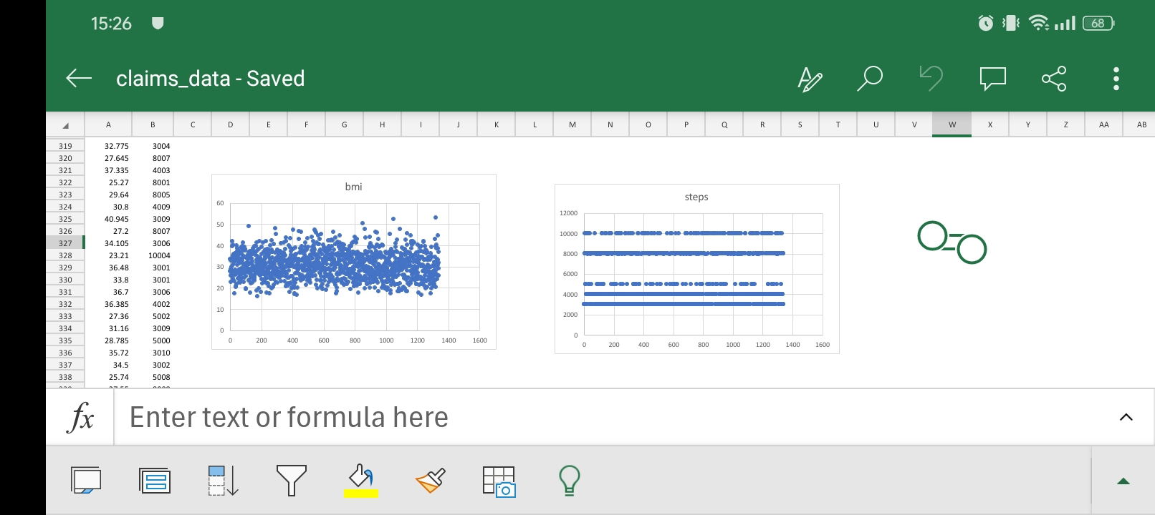
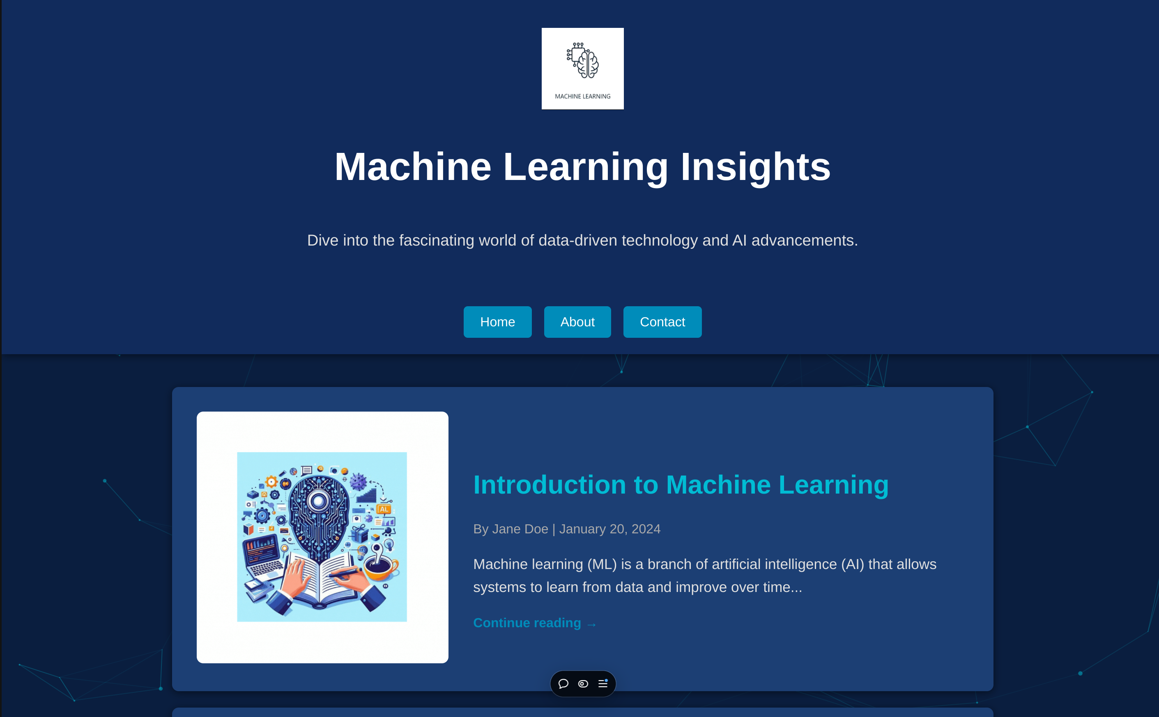
Screenshots.

Slide 5
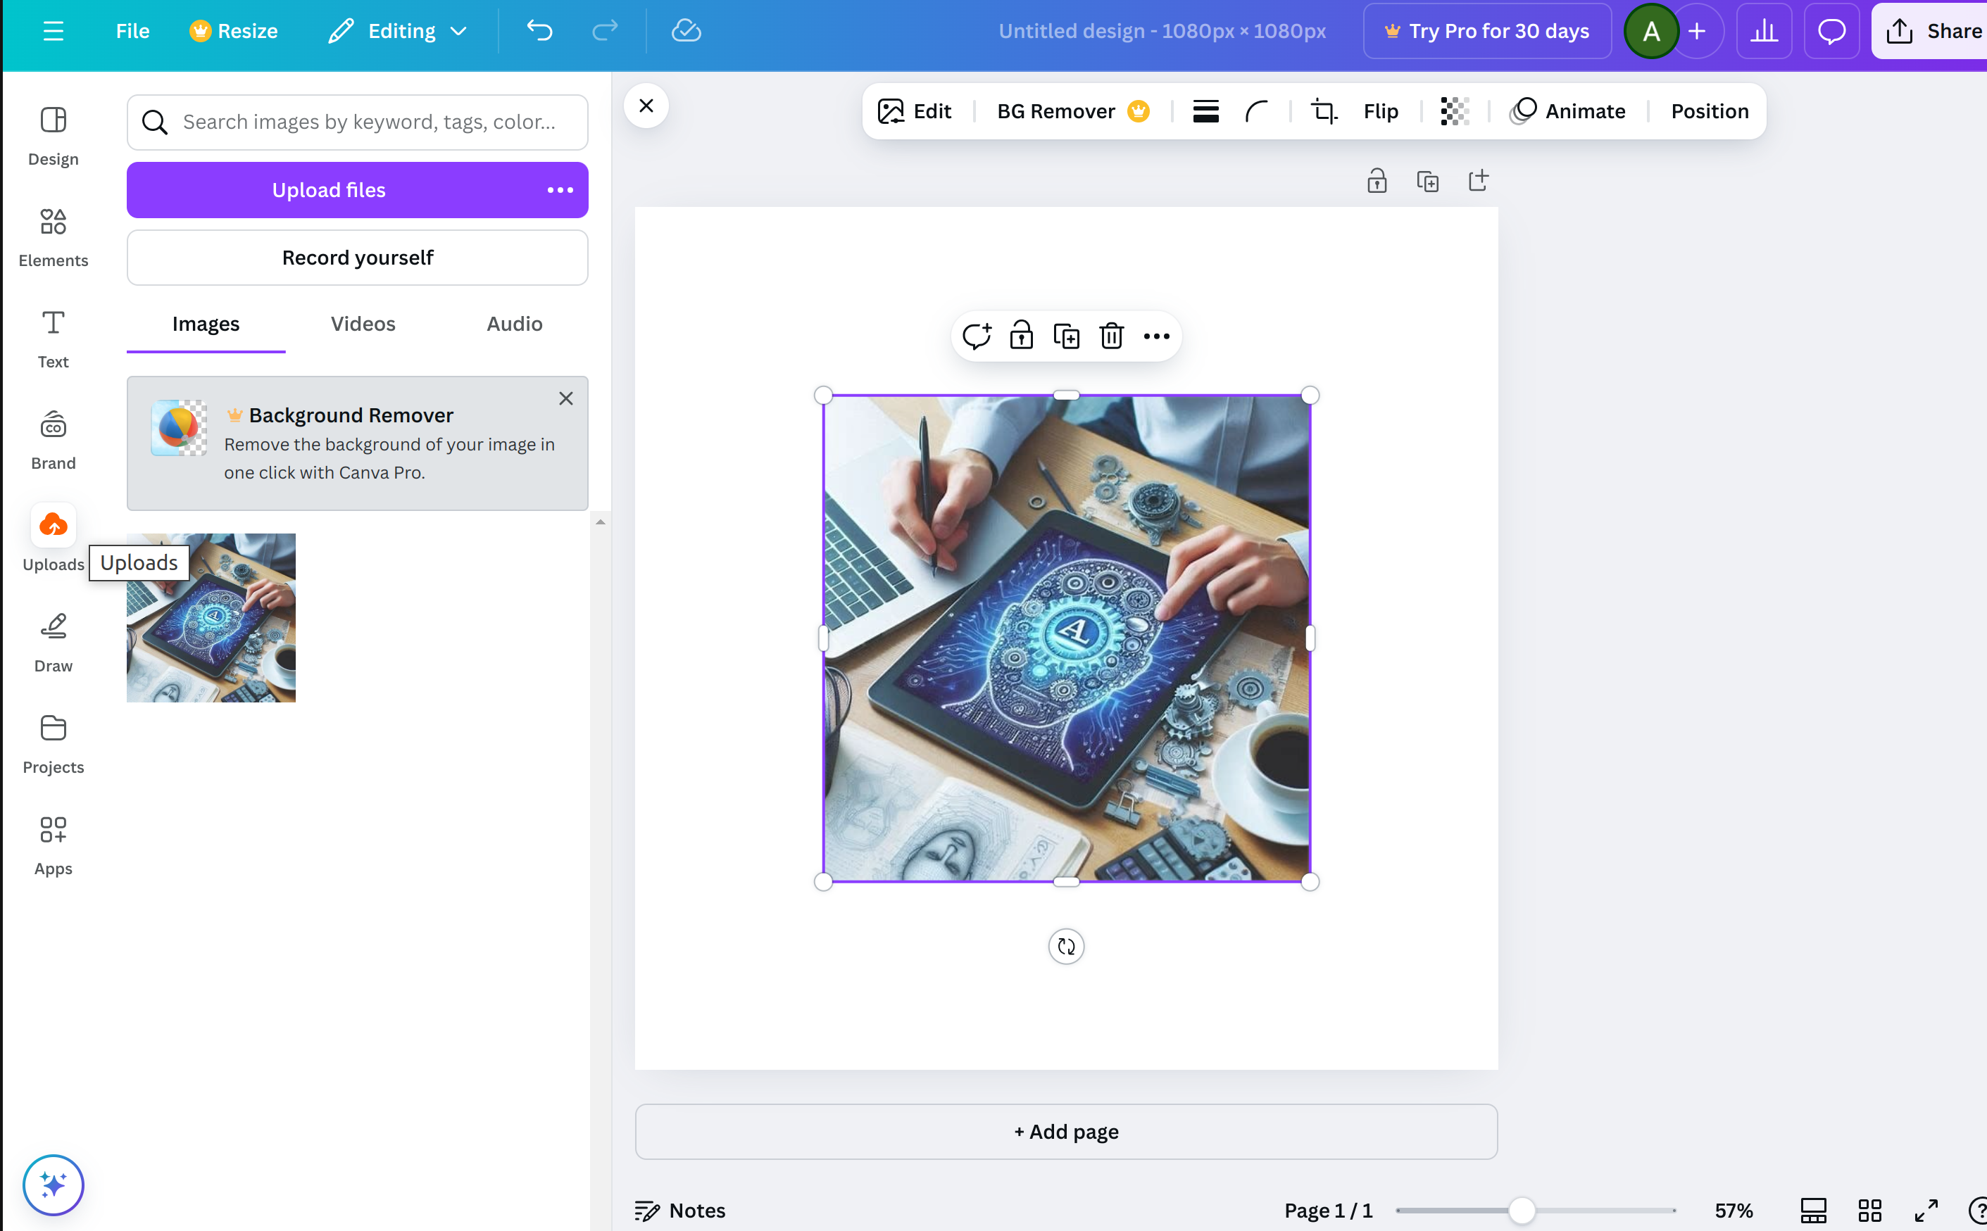
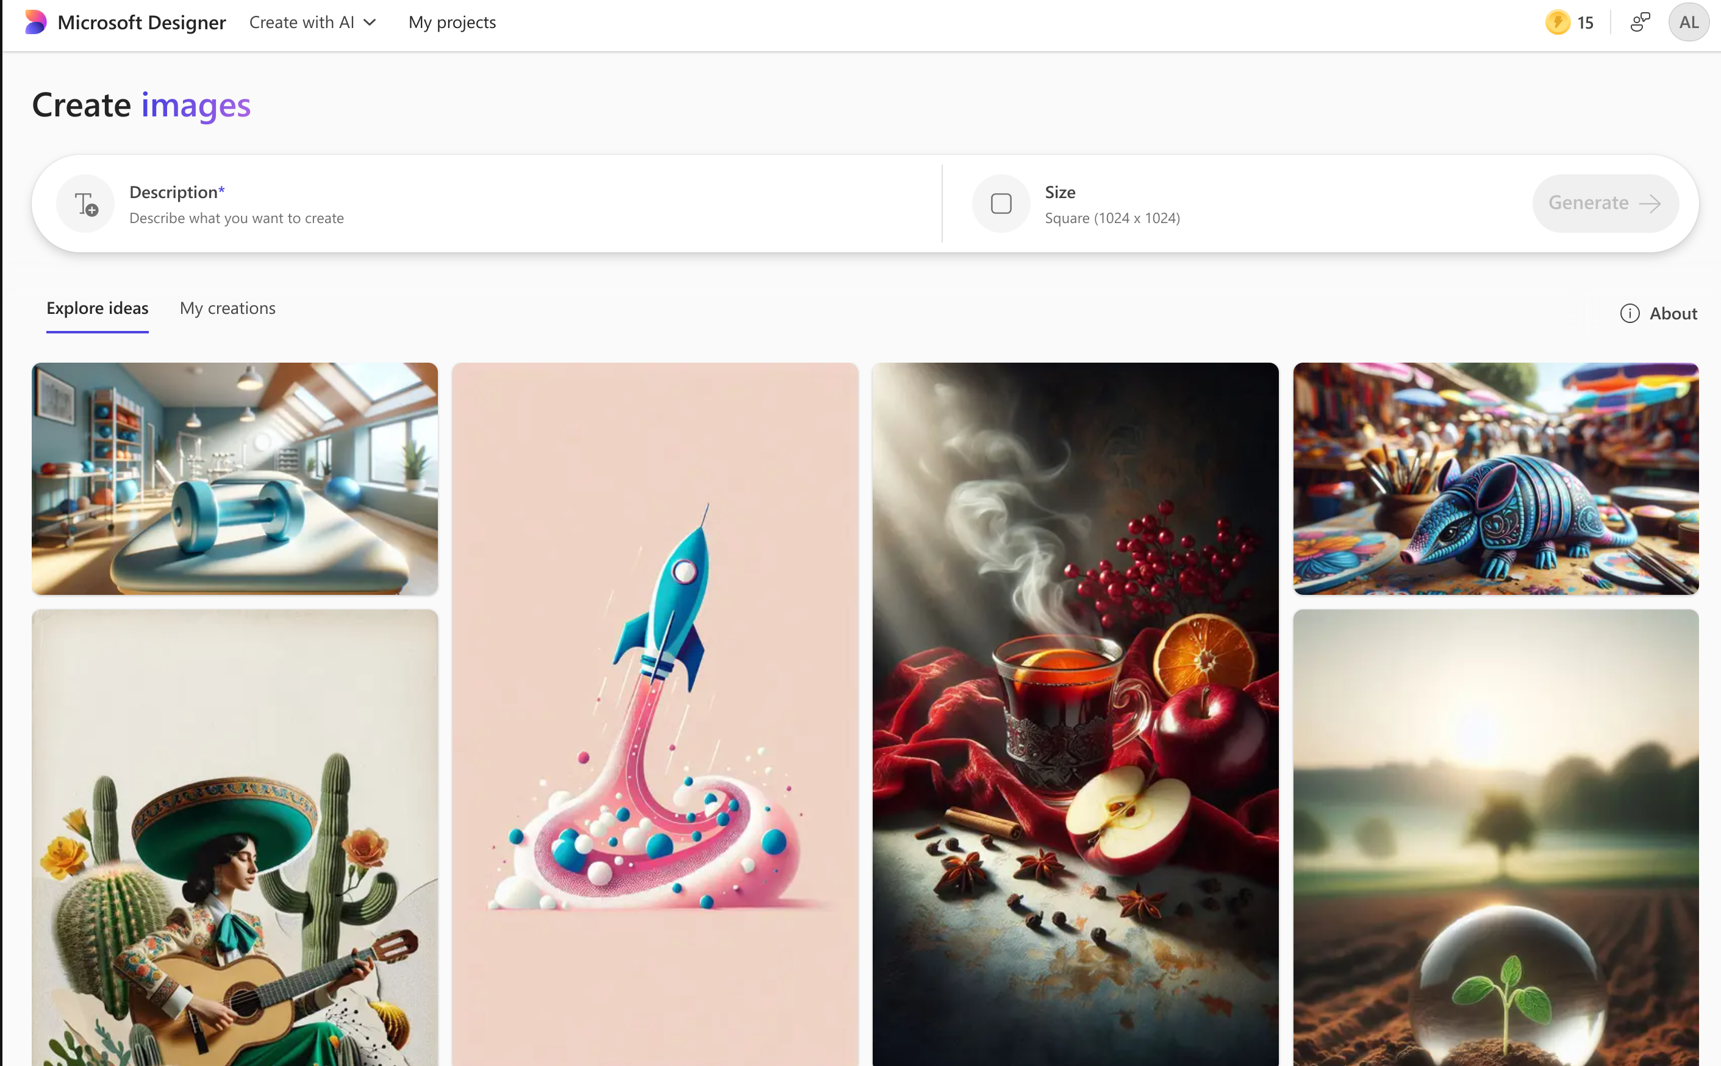
Screenshots

